Slide 1


Chua Ding Zhang
<Date>

Slide 2

Outline
Executive Summary
Introduction
Methodology
Results
Conclusion
Appendix

Slide 3
Executive Summary
SpaceX API data was collected from Wikipedia page. Labels were created with column ‘class’ to signify successful landing
Data was explored and visualized. The categorical variables were changed to binary using one hot encoding and GridSearchCV was used for standardized data to find the best parameters for machine learning models.
Four machine learning models presented, similar results produced from models: logistic regression, support vector machine, decision tree and K nearest neighbors yielded an accuracy of 83%.

Slide 4
Introduction
Background
Commercial space travelling
Space X launches promises the best pricing of $62 million compared to $165 million of commercial pricing.
By reusing parts from 1st stage of launch
Space Y competing with Space X
Problem
Tasked by Space Y to use machine learning to predict successful stage 1 recovery

Slide 5

Section 1

Slide 6
Methodology
Executive Summary
Data collection methodology:
Through Wikipedia page and Space X public API
Perform data wrangling
Successful and unsuccessful landings are classified
Perform exploratory data analysis (EDA) using visualization and SQL
Perform interactive visual analytics using Folium and Plotly Dash
Perform predictive analysis using classification models
Models were used by GridSearchCV

Slide 7
Data Collection
The data involved is a combination of API request from Space X public API and web scraping from Wikipedia
Flowchart will show a detailed data collection from API
Space X API data columns:
FlightNumber, Date, BoosterVersion, PayloadMass, Orbit, LaunchSite, Outcome, Flights, GridFins, Reused, Legs, LandingPad, Block, ReusedCount, Serial, Longitude, Latitude
Wikipedia web scrape columns:
Flight number, Launch site, Payload, PayloadMass, Orbit, Customer, Launch outcome, Version Booster, Booster landing, Date, Time

Slide 8
Data Collection – SpaceX API
https://github.com/dzchua/assignrepo/blob/main/jupyter-labs-spacex-data-collection-api.ipynb
Request (Space X APIs)
Filter data to only include Falcon 9 launches
Imputate missing PayloadMass values with mean
.JSON file + Lists(Launch Site, Booster Version, Payload Data)
Cast dictionary to a DataFrame
Json_normalize to DataFrame data from JSON
Dictionary relevant data

Slide 9
Data Collection - Scraping
Request Wikipedia
html
Cast dictionary to DataFrame
https://github.com/dzchua/assignrepo/blob/main/jupyter-labs-webscraping%20(1).ipynb
Iterate through table cells to extract data to dictionary
BeautifulSoup
html5lib Parser
Find launch info html table
Create dictionary

Slide 10
Data Wrangling
Landing outcomes: successful = 1 and unsuccessful = 0
Outcome column contains mission outcome and landing location
https://github.com/dzchua/assignrepo/blob/main/labs-jupyter-spacex-Data%20wrangling.ipynb

Slide 11
EDA with Data Visualization
Visualization on variables performed were Flight Number, Payload Mass, Launch Site, Orbit, Class and Year.
Plotted graph used
Flight Number vs. Payload Mass, Flight Number vs. Launch Site, Payload Mass vs. Launch Site, Orbit vs. Success Rate, Flight Number vs. Orbit, Payload vs Orbit, and Success Yearly Trend
By using scatter plot, line, and bar chart
https://github.com/dzchua/assignrepo/blob/main/jupyter-labs-eda-dataviz.ipynb

Slide 12
EDA with SQL
Data was loaded into IBM DB2
SQL Python to query information previously stated

Slide 13
Build an Interactive Map with Folium
Folium maps mark launch sites, successful landings and key proximity locations: highway, coast, railway and city
The purpose of this is to visualize the approximated launched sites and success landings relative to location
https://github.com/dzchua/assignrepo/blob/main/lab_jupyter_launch_site_location.ipynb

Slide 14
Build a Dashboard with Plotly Dash
Includes pie chart and scatter plot
Pie chart shows successful landings across all launch sites
Scatter plot is either all launch sites or payload mass on slider between 0 to 10000kg
Pie chart is used for success rate and scatter plot is shown for various success parameters such as payload mass, booster version and launch sites.
https://github.com/dzchua/assignrepo/blob/main/Plotly%20Dash

Slide 15
Predictive Analysis (Classification)
Split label column
Score models on
Confusion Matrix
‘Class’ from dataset
split test set
for all models
https://github.com/dzchua/assignrepo/blob/main/SpaceX_Machine%20Learning%20Prediction_Part_5.ipynb
Fit and Transform
Use GridSearchCV
Features using
on LogReg, SVM,
Barplot to compare scores of models
Standard Scaler
Decision Tree, and
KNN models
Train_test_split
GridSearchCV
data
(cv=10) to find optimal parameters

Slide 16
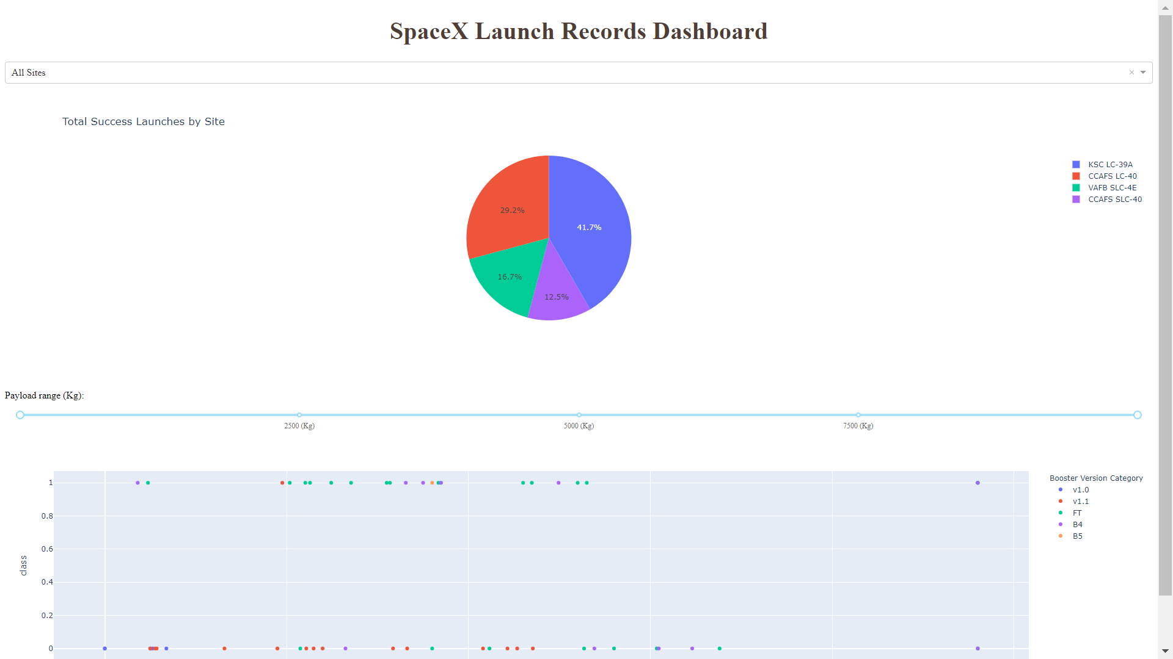
Results
Dashboard of launch records

Slide 17

Section 2

Slide 18
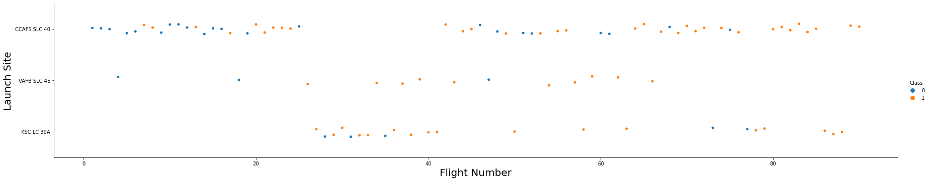
Flight Number vs. Launch Site
1 = success launches, 0 = unsuccessful launches
Middle and bottom models have higher rate of successes
As flight number increases, the top model failures decreases

Slide 19
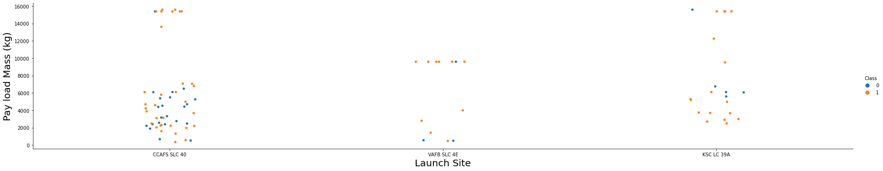
Payload vs. Launch Site
Middle launch site has lower number of test but had high rate of successes
Left side model, when payload mass increases to >3000kg, success rate increased

Slide 20
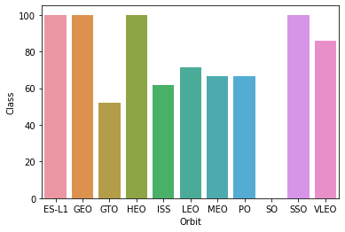
Success Rate vs. Orbit Type
ES-L1 (1), GEO (1), HEO (1) have 100% success rate SSO (5) has 100% success rate
VLEO (14) has decent success rate and attempts
SO (1) has 0% success rate
GTO (27) has the around 50% success rate but largest sample
Number of test are represented in parenthesis

Slide 21
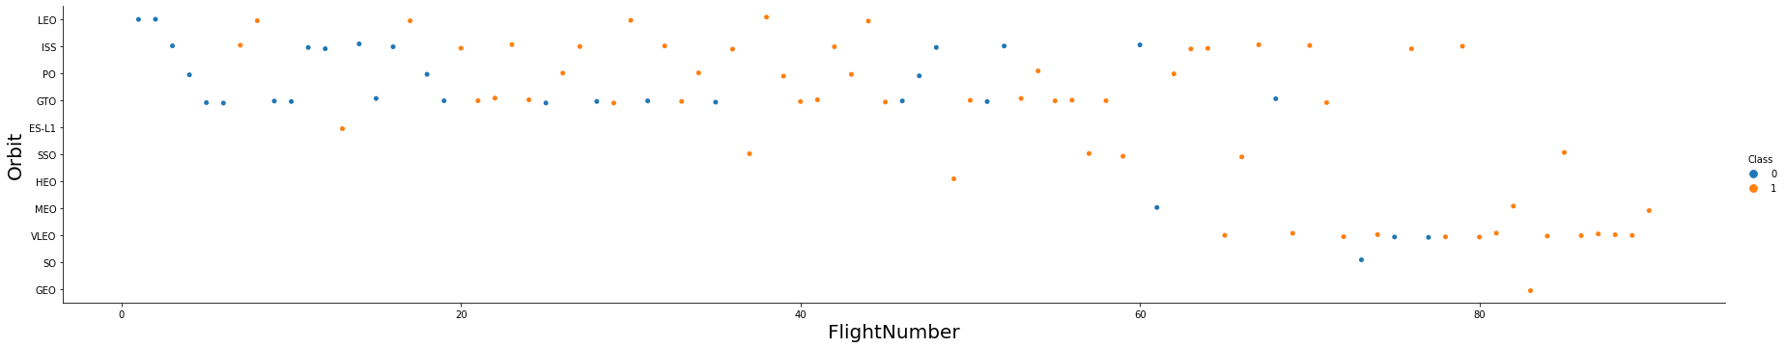
Flight Number vs. Orbit Type
Successes of launch were mainly located at middle-bottom area of this chart

Slide 22
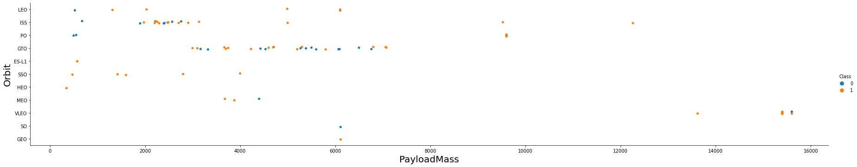
Payload vs. Orbit Type
Low failure rate as payload mass is higher
Similarly as previous chart, middle-bottom orbits posted higher rate of success

Slide 23
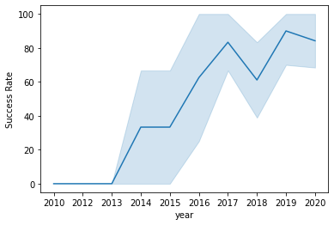
Launch Success Yearly Trend

Slide 24
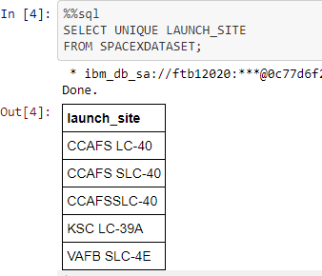
All Launch Site Names
Duplicates on row 2 and 3 CCAFS SLC-40 was found.
Most likely 3 unique launch sites

Slide 25
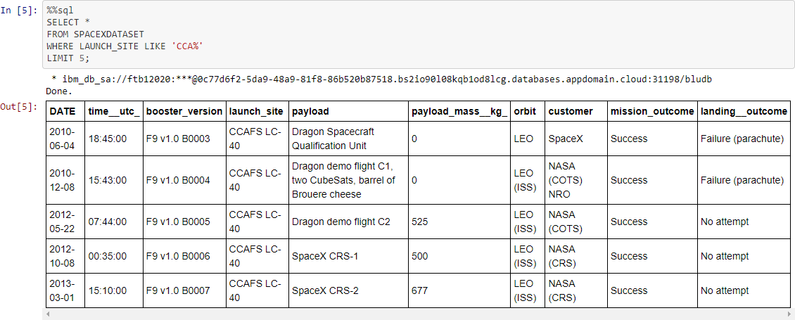
Launch Site Names Begin with 'CCA'
Five CCA launch sites queried
Two failure landing outcome but mission outcome all succeeded
All launched at different timing

Slide 26
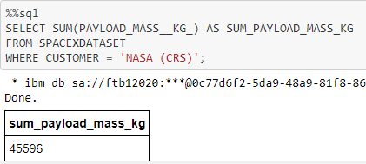
Total Payload Mass
Total payload mass is from NASA
CRS is Commercial Resupply Services, the payloads were sent to the ISS by CRS

Slide 27
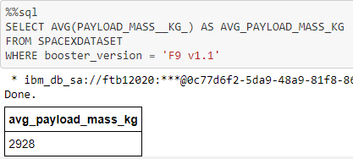
Average Payload Mass by F9 v1.1
Booster version ‘F9 V1.1’ average payload was 2928kg

Slide 28
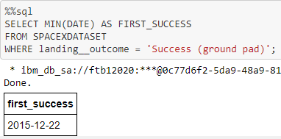
First Successful Ground Landing Date
Success Landing outcome is dated and located at ground pad

Slide 29
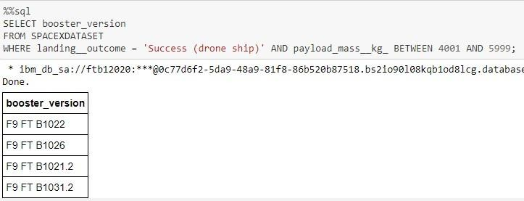
Successful Drone Ship Landing with Payload between 4000 and 6000
Success drone ship landing are queried with four different versions

Slide 30
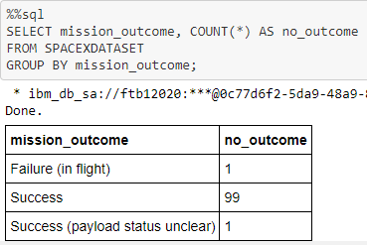
Total Number of Successful and Failure Mission Outcomes
Mission outcome with 99 success
One failure in flight
One with unclear payload status

Slide 31
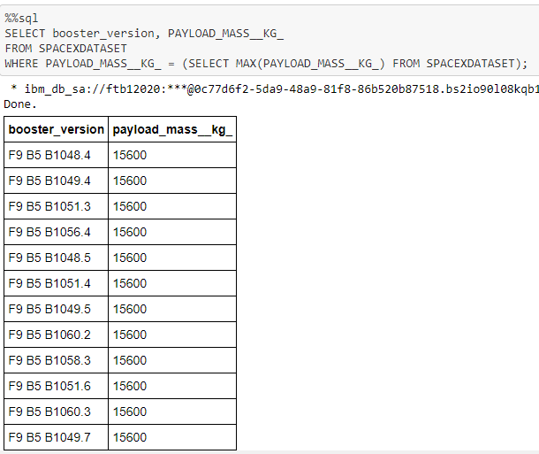
Boosters Carried Maximum Payload
Twelve versions were listed for max of 15600kg payload

Slide 32
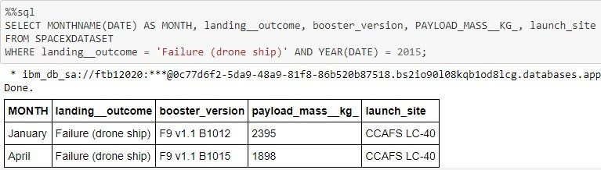
2015 Launch Records
January and April were launched failure

Slide 33
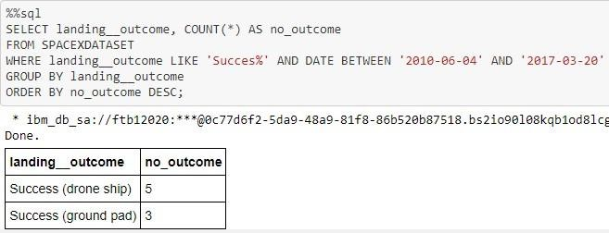
Rank Landing Outcomes Between 2010-06-04 and 2017-03-20
Two successes were listed
Drone ship and ground pad

Slide 34

Section 3

Slide 35
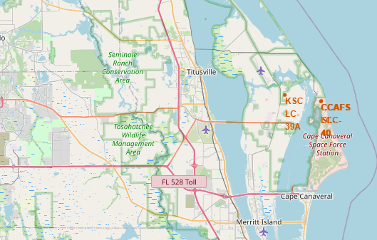
Launch Site
Launch sites were highlighted in red and near the coast line

Slide 36
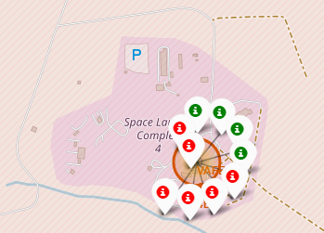
Launch Markers
Folium map for the launch site is marked with failed (red) and successful (green) landing. Six failed while four succeeded

Slide 37
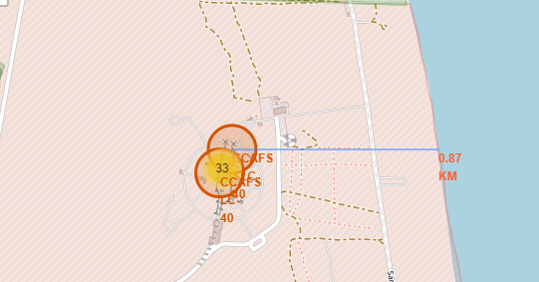
Location Proximities
CCAFS SLC-40 relative distance to the coastline is shown. 0.87KM seems to be a safe distance to launch

Slide 38

Section 4

Slide 39


Launches Across Launch Sites
Four successful launch sites are shown, KSC LC-39A having the highest number of success launches.

Slide 40

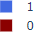
Launch Site with Highest Success Rate
Out of thirteen landings, three failed.

Slide 41

Payload Mass vs Booster Version vs Success Category

Slide 42

Section 5

Slide 43

Classification Accuracy
Sample size of 18 was used
Each models yielded the same accuracy
More data is needed to see the difference in spread

Slide 44

Confusion Matrix
Three landings that did not land came out as landed (false positive)
All landed launches came out as success (true positive)

Slide 45
Conclusions
Flight number vs Launch site: VAFB SLC 4E and KSC LC 39A posted least amount of failure with least amount of flight tested
Payload vs Launch site: CCAFS SLC 40 was heavily used at payload <7000kg. Failed landings are minority however, it is inconclusive to compare with other sites on which is the best outcome due to the amount of launched site used.
Success rate vs Orbit type: ES-L1, GEO, HEO, SSO had 100% success rate but had only one sample size. VLEO had 14 success attempts and had >80% success rate.
Success rate over the years were plotted showing an increased upward trend of successes from year 2013 to 2020
More data is needed to determine the best machine learning model to justify the accuracy of models as they were equally accurate.

Slide 46
Appendix
Include any relevant assets like Python code snippets, SQL queries, charts, Notebook outputs, or data sets that you may have created during this project

Slide 47


